Slide 1
Deploying Services with Kubernetes
Lecturer: Ngo Huy Bien
Software Engineering Department
Faculty of Information Technology
VNUHCM - University of Science
Ho Chi Minh City, Vietnam
nhbien@fit.hcmus.edu.vn

Slide 2

Objectives

Slide 3

Contents
Helm

Slide 4

References

Slide 5
Helm
Kubernetes apps are modeled in a sprawl of YAML files at design time and managed using sets of labels at run time.
There’s no native concept of an “application” in Kubernetes, which clearly groups together a set of related resources, and that’s one of the problems Helm solves.
It’s a command-line tool that interacts with repository servers to find and download application packages and, with your Kubernetes cluster, to install and manage applications.

Slide 6
Helm Repositories
Helm repositories are similar to container image registries like Docker Hub, but the server publishes an index of all available packages.
Helm caches a local copy of your repository indexes, which you can use to search packages.

Slide 7
Charts
An application package in Helm is called a chart.
Charts can be developed and deployed locally or published to a repository.
When you install a chart, that’s called a release.
Every release has a name, and you can install multiple instances of the same chart in your cluster as separate, named releases.

Slide 8
Charts and Manifests
Charts contain Kubernetes YAML manifests, and the manifests typically contain parameterized values so users can install the same chart with different configuration settings—the number of replicas to run or the application logging level could be parameter values.
Each chart also contains a default set of values, and they can be inspected using the command line.

Slide 9
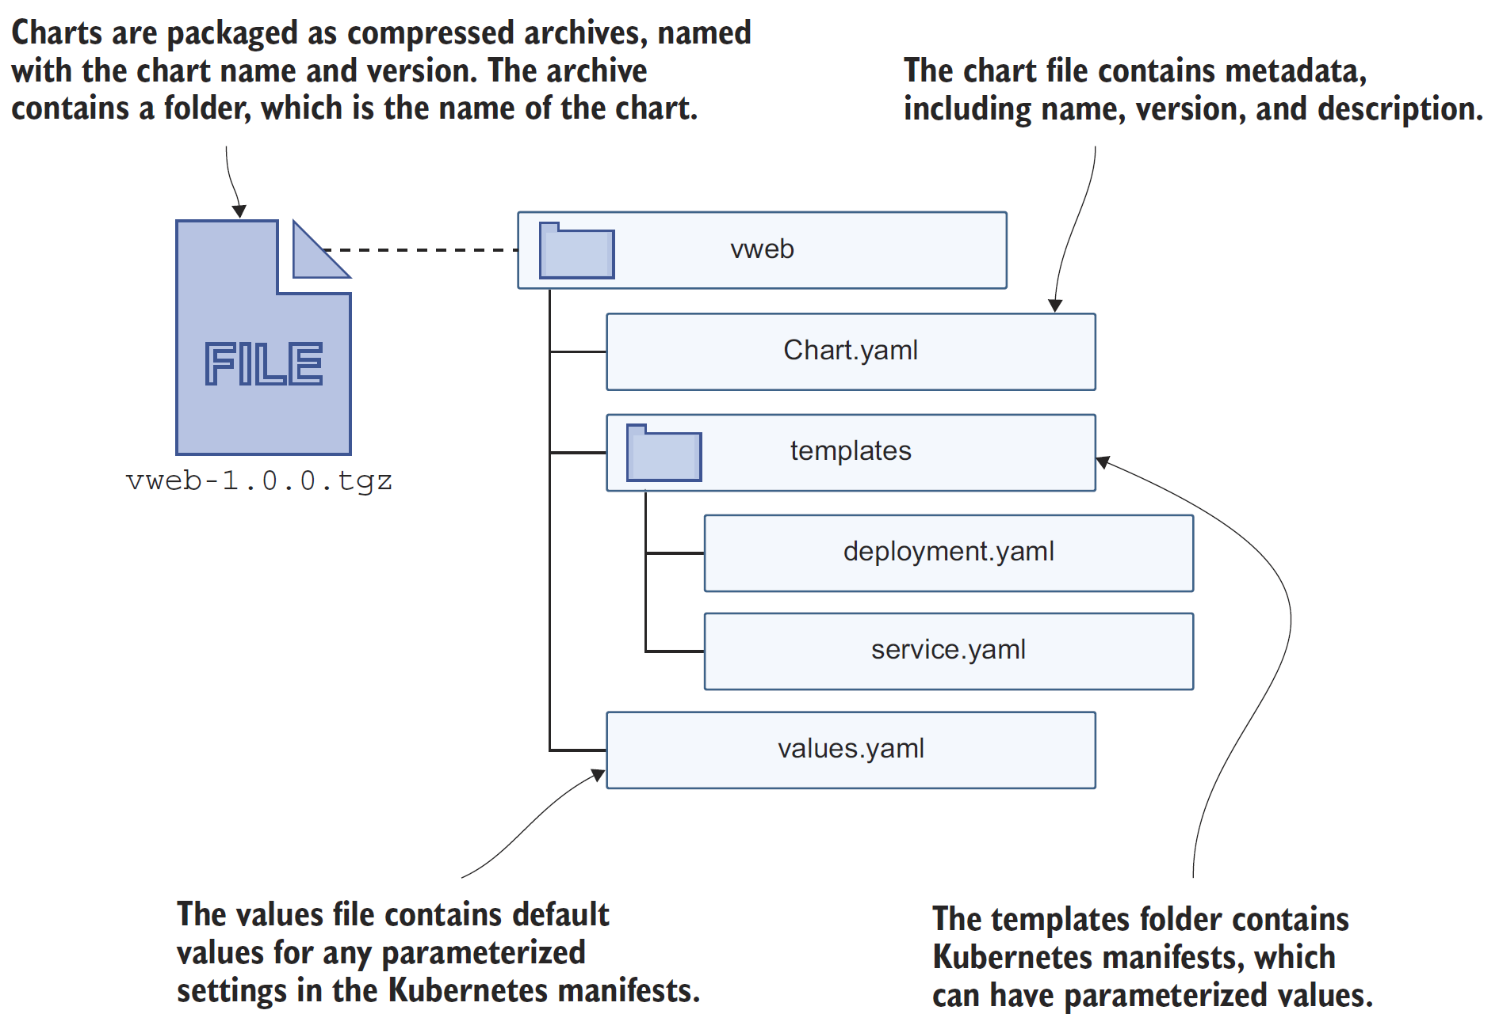
Chart Components

Slide 10
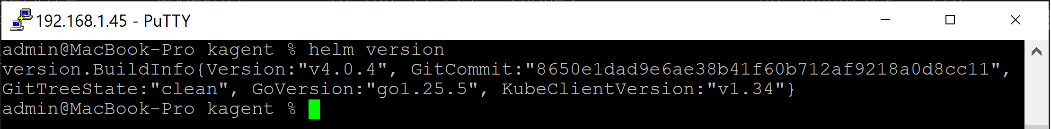
1. Install Helm on macOS
https://helm.sh/docs/intro/install/
brew install helm
helm version

Slide 11
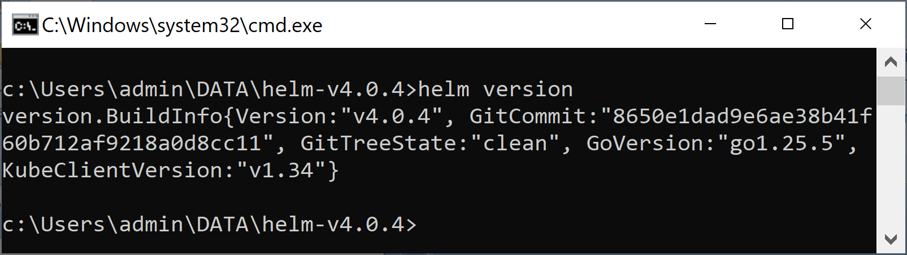
2. Install Helm on Windows
https://github.com/helm/helm/releases
Download https://get.helm.sh/helm-v4.0.4-windows-amd64.zip
Extract the zip file.
helm version

Slide 12


Slide 13
Deploying PHP Guestbook application with Redis
https://kubernetes.io/docs/tutorials/stateless-application/guestbook/
The web application must communicate with the Redis followers to read data. To make the Redis followers discoverable, you must set up a Service.

Slide 14
1. Create Redis leader Deployment
See redis-leader-deployment.yaml
kubectl apply -f https://k8s.io/examples/application/guestbook/redis-leader-deployment.yaml
kubectl get service
kubectl logs -f deployment/redis-leader

Slide 15
2. Create Redis leader Service
The web application needs to communicate with the Redis leader to write its data. You can create a Service to proxy the traffic to the Redis leader Pod.
See redis-leader-service.yaml
This manifest includes a set of label selectors. These labels match the set of labels that are deployed in the previous step. Therefore, this Service routes the network traffic to the Redis leader Pod created in a previous step.
kubectl apply -f https://k8s.io/examples/application/guestbook/redis-leader-service.yaml
kubectl get pods
kubectl logs -f deployment/redis-leader

Slide 16
3. Create Redis followers Deployment
Although the Redis leader is a single Pod, you can make it highly available and meet traffic demands by adding a few Redis followers, or replicas.
See redis-follower-deployment.yaml
Followers will find leader by name (i.e. "redis-leader")?
kubectl apply -f https://k8s.io/examples/application/guestbook/redis-follower-deployment.yaml
kubectl get pods

Slide 17
4. Create Redis followers Service
The web application must communicate with the Redis followers to read data. To make the Redis followers discoverable, you must set up a Service.
See redis-follower-service.yaml
The selector field of the Service matches the Redis follower Pods created in the previous step.
kubectl apply -f https://k8s.io/examples/application/guestbook/redis-follower-service.yaml
kubectl get service

Slide 18
5. Create Frontend Deployment
The web application uses a PHP frontend, which is configured to communicate with either the Redis follower or leader Services, depending on whether the request is a read or a write.
See frontend-deployment.yaml
The manifest file specifies the environment variable GET_HOSTS_FROM=dns. When you provide the configuration to the web frontend application, the frontend application uses the hostnames redis-follower and redis-leader to performs a DNS lookup.
kubectl apply -f https://k8s.io/examples/application/guestbook/frontend-deployment.yaml
kubectl get pods -l app=guestbook -l tier=frontend

Slide 19
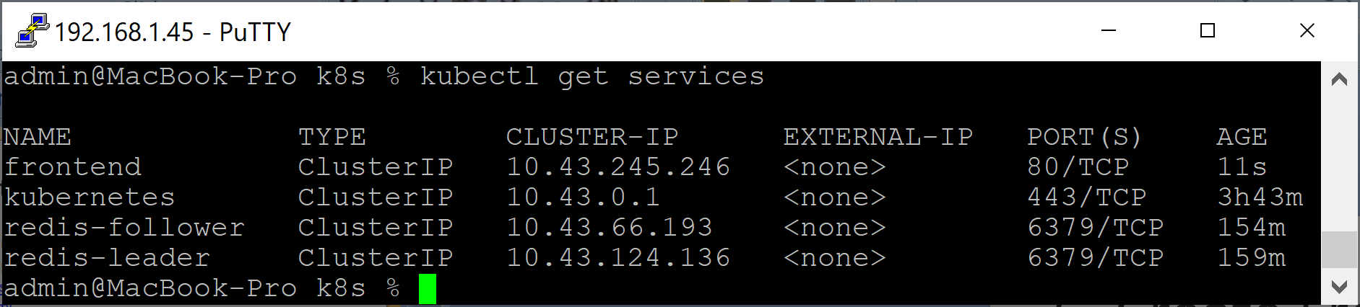
6. Create Frontend Service
See frontend-service.yaml
kubectl apply -f https://k8s.io/examples/application/guestbook/frontend-service.yaml
kubectl get services

Slide 20
7. Open Frontend Service
kubectl port-forward svc/frontend 8080:80
load the page http://localhost:8080 in your browser
kubectl get service frontend
# kubectl delete service frontend
# kubectl apply -f frontend-service-lb.yaml
# EXTERNAL-IP = <none>

Slide 21
8. Scale Frontend
kubectl scale deployment frontend --replicas=5
kubectl get pods
kubectl scale deployment frontend --replicas=2
kubectl get pods

Slide 22
9. Clean up
kubectl delete deployment -l app=redis
kubectl delete service -l app=redis
kubectl delete deployment frontend
kubectl delete service frontend

Slide 24
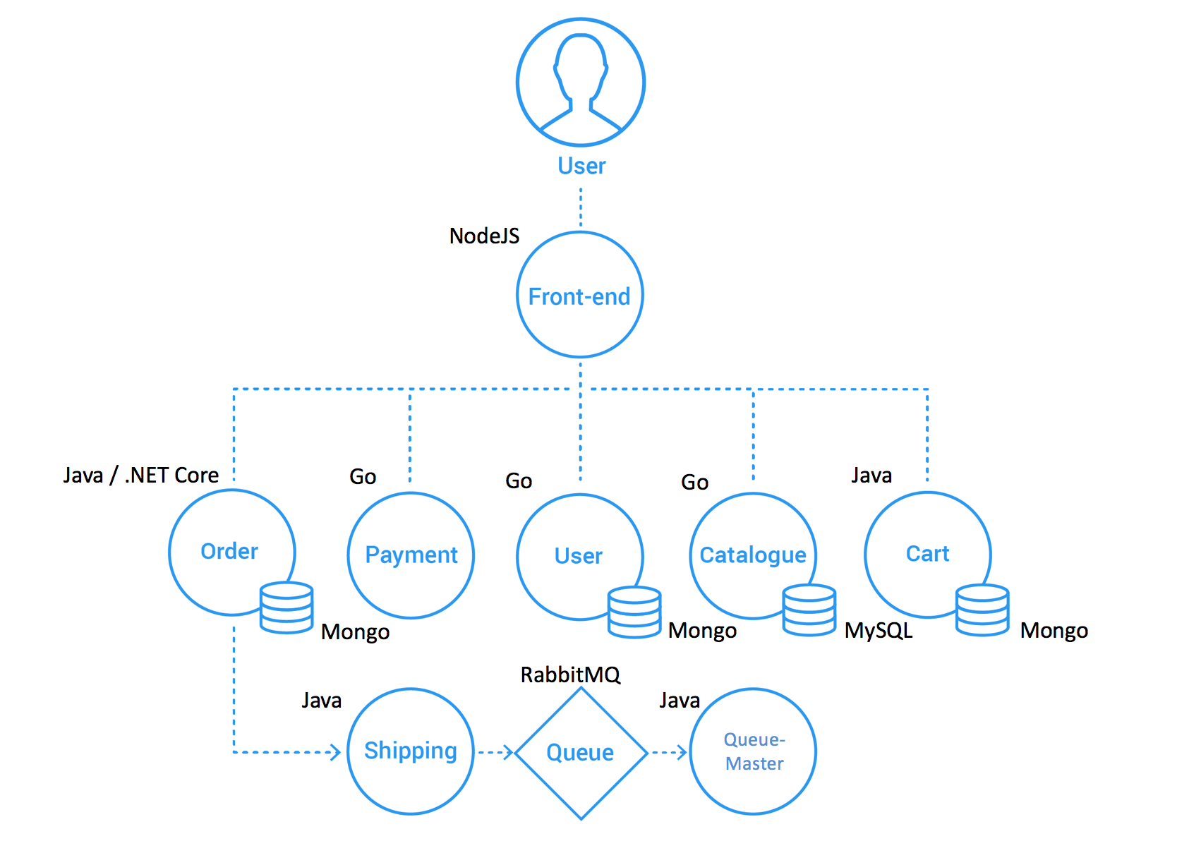
Sock Shop: A Microservices Demo
https://github.com/orgs/microservices-demo/repositories?type=all

Slide 25
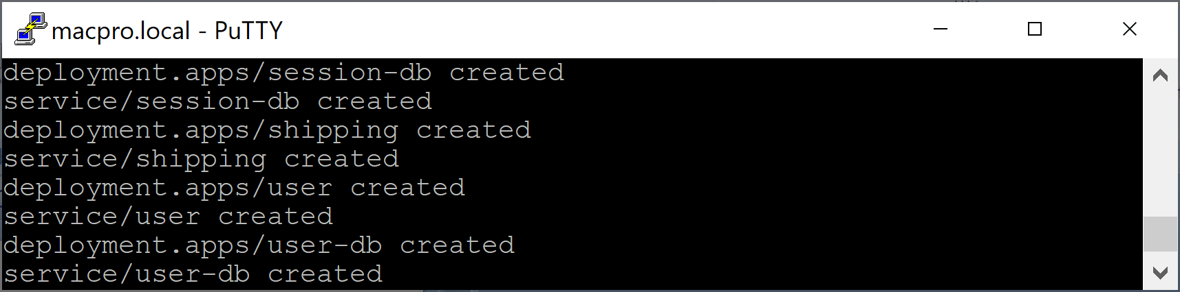
1. Deploy Sock Shop
kubectl get nodes
mimikube start
git clone https://github.com/microservices-demo/microservices-demo
ls
cd microservices-demo/deploy/kubernetes
kubectl create namespace sock-shop
kubectl apply -f complete-demo.yaml

Slide 26
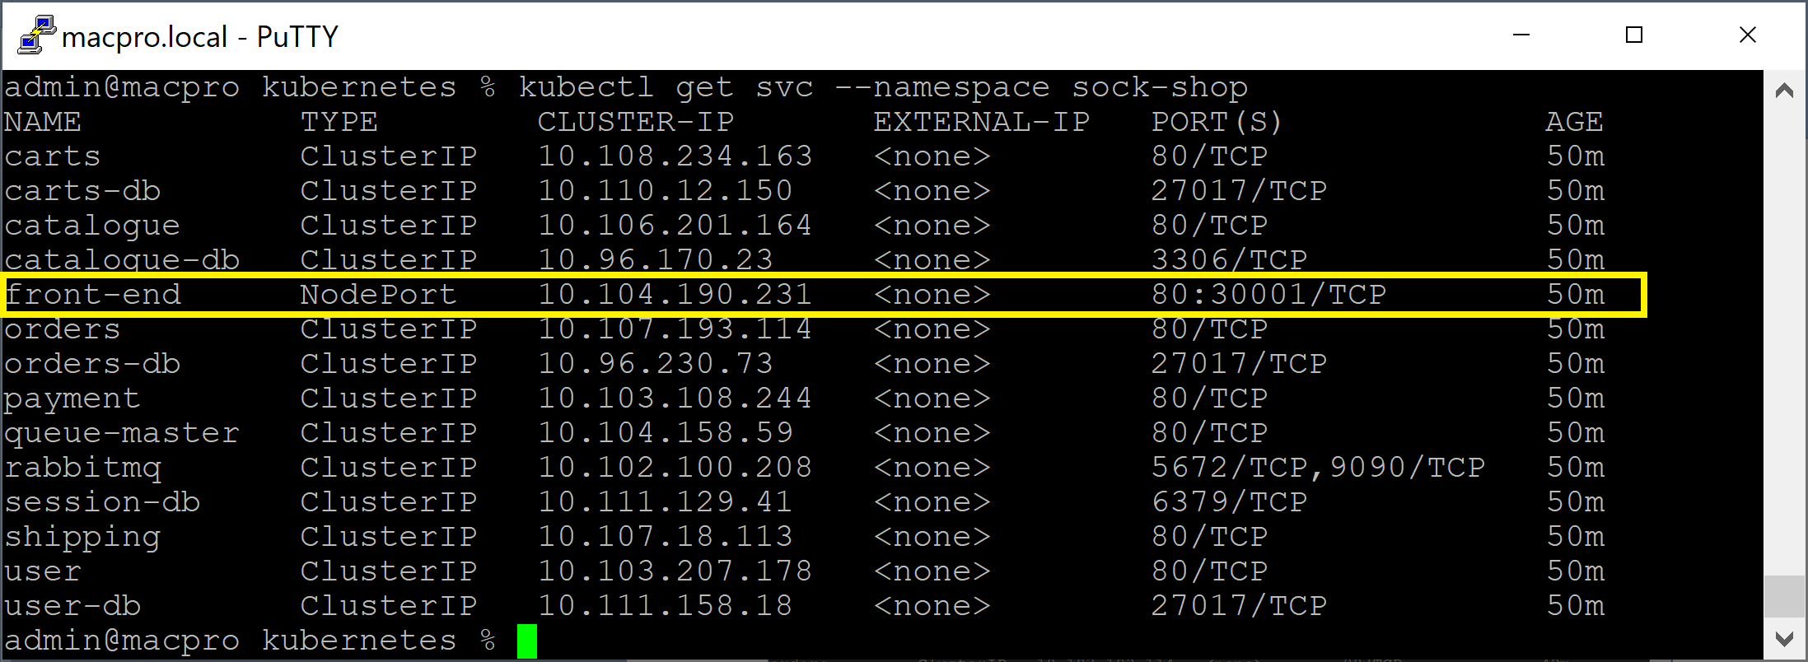
2. View Namespace Services
kubectl get svc --namespace sock-shop

Slide 27
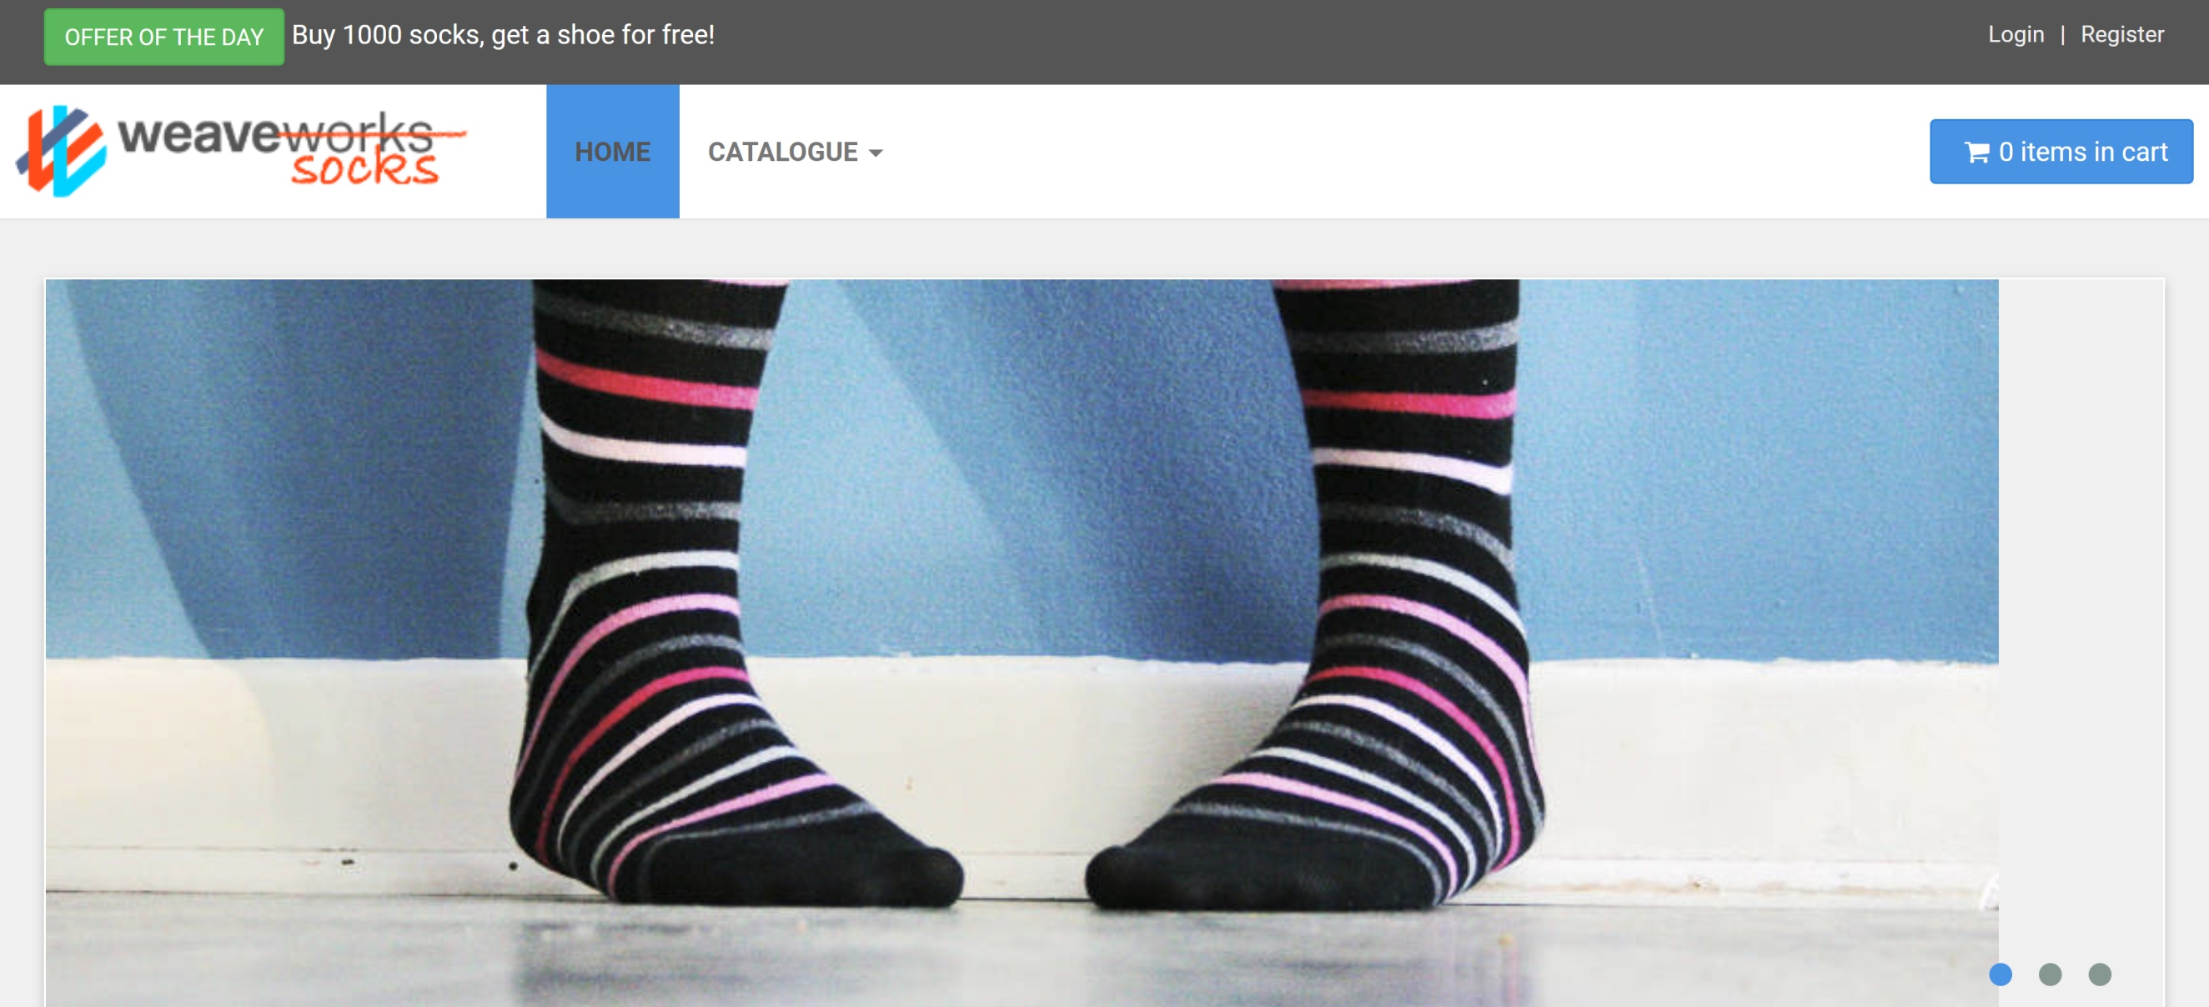
3. View the Website
minikube service front-end -n sock-shop

Slide 28
4. Modify the Service
kubectl edit svc front-end -n sock-shop
// Press i
// Change something
// Press ESC
// Type :wq

Slide 29
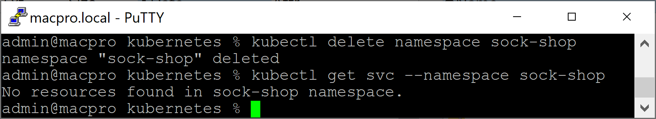
5. Clean Up
kubectl delete namespace sock-shop
kubectl get svc --namespace sock-shop

Slide 30
Further Reading
https://medium.com/@CloudTopG/unleash-the-power-of-kubernetes-with-terraform-deploy-sock-shop-microservice-like-a-pro-572670a0d28f

Slide 31

Thank You & See You Again

